Slide 1
Digital Portfolio
STUDENT NAME: KARTHIKA DEVI .B
REGISTER NO AND NMID: 2422k0933 & 7F6711FD35862DBAA744C41172A44DA8
DEPARTMENT: Bsc COMPUTER SCIENCE
COLLEGE: COLLEGE/ UNIVERSITY : TIRUPPUR KUMARAN COLLEGE FOR WOMEN / BHARATHIYAR UNIVERSITY

Slide 2
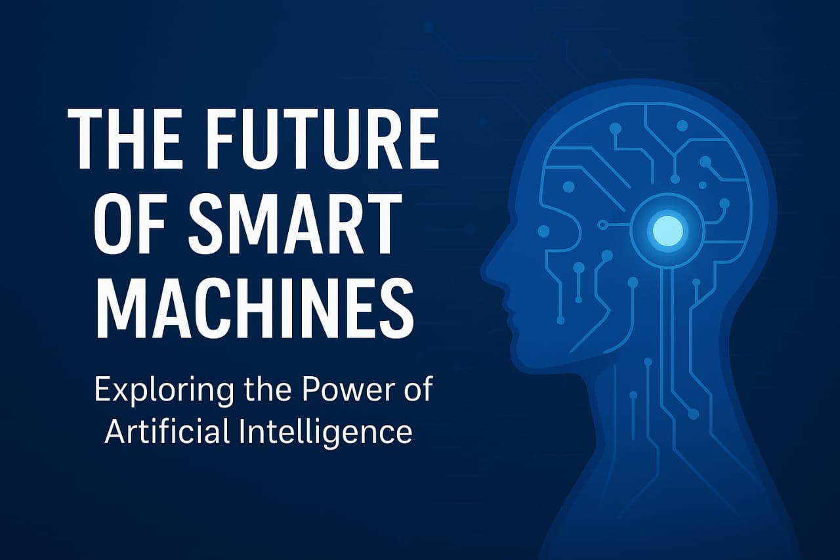
PROJECT TITLE

Slide 3


AGENDA
Problem Statement
Project Overview
End Users
Tools and Technologies
Portfolio design and Layout
Features and Functionality
Results and Screenshots
Conclusion
Github Link
3/21/2024 Annual Review

Slide 4

PROBLEM STATEMENT
Design and develop a responsive web-based portfolio using HTML, CSS, and JavaScript that showcases machine learning, artificial intelligence, and data-driven projects for future-ready smart systems. The portfolio should allow users to view individual project details, highlight technical skills relevant to smart machines (e.g., time-series forecasting, deep learning, IoT integrations), and provide interactive navigation for mobile and desktop devices.

Slide 5

PROJECT OVERVIEW
The smart machine portfolio coding project demonstrates a strong approach to showcasing machine learning and AI capabilities through an interactive, modern web interface. The project uses best practices for clear structure and responsive design, making it both practical and impressive to various audiences.

Slide 6

WHO ARE THE END USERS?
Recruiters and Employers: Hiring managers and tech recruiters seeking talent in AI, machine learning, and software development use portfolios to evaluate candidates’ skills and project experience. Academic Institutions: Professors, admission committees, and research supervisors may review portfolios for student admissions, grant applications, or technical competitions in the smart systems field.

Slide 7

TOOLS AND TECHNIQUES
Key tools and techniques for developing a smart machine portfolio website using HTML, CSS, and JavaScript revolve around modern web frameworks, automation utilities, and design best practices. These facilitate building a robust, interactive, and future-ready platform for showcasing smart machine projects

Slide 8
POTFOLIO DESIGN AND LAYOUT
The smart machine portfolio features a clean, modern, and responsive design with a fixed header, clear sections for Home, Skills, Projects, and Contact, and interactive elements like animated text and mobile-friendly navigation. Projects are showcased as image cards with descriptions, using flexbox for layout and media queries for mobile responsiveness, ensuring an engaging and professional presentation of AI and machine learning skills.
8

Slide 9
FEATURES AND FUNCTIONALITY
Responsive navigation with mobile toggle Animated dynamic header text Clear skills listing Project cards with images and descriptions Interactive contact form with input validation User friendly

Slide 10
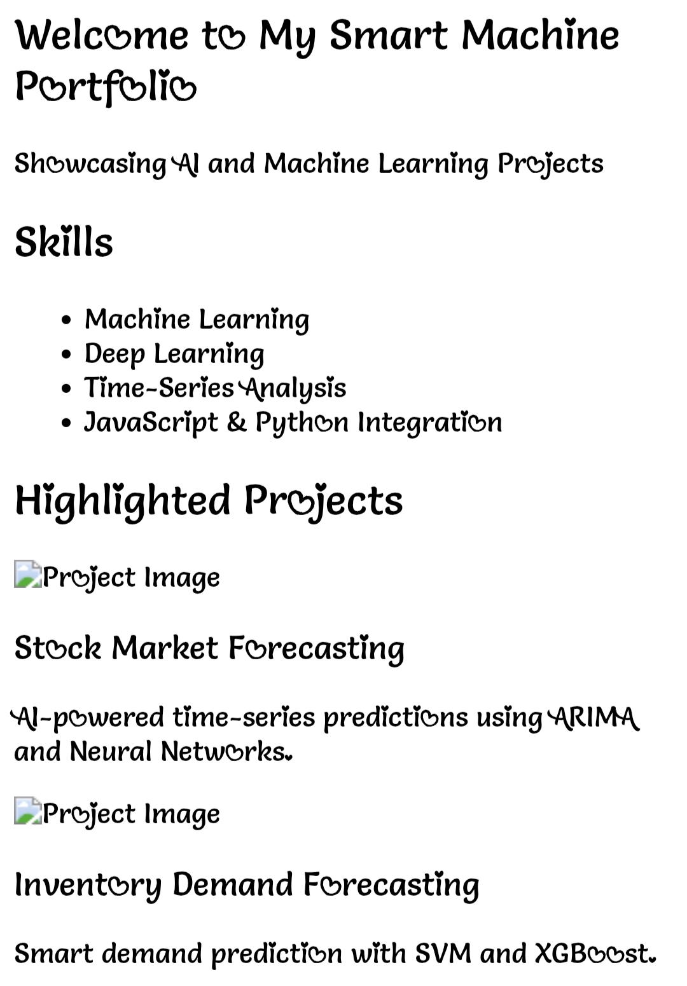

RESULTS AND SCREENSHOTS
3/21/2024 Annual Review
10

Slide 11
CONCLUSION
The smart machine portfolio coding project provides an effective, modern platform to showcase AI and machine learning expertise. It combines responsive design, interactive features, and clear project presentations to engage recruiters, collaborators, and technical audiences. This portfolio not only highlights current skills and projects but also positions the creator as adaptable to future advancements in smart machine technologies. Overall, it serves as a professional gateway for career opportunities, networking, and demonstrating technical depth in emerging intelligent systems.
11

